Slide 1
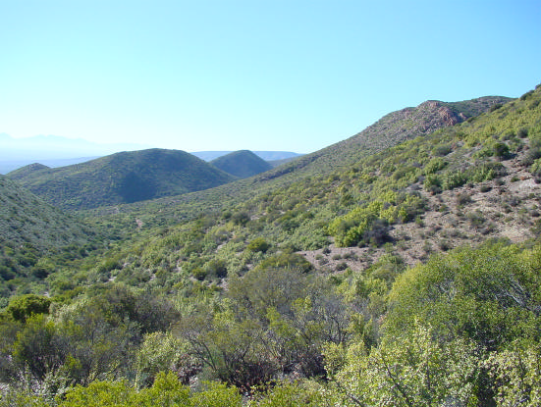
Very High Resolution Remote Sensing of Spekboom Canopy Cover
Dugal Harris¹
Adriaan Van Niekerk²
Jan Vlok³
Department of Geography & Environmental Studies, Stellenbosch University
Centre for Geographical Analysis, Stellenbosch University
Research Associate, Nelson Mandela Metropolitan University
[Source: J. Vlok]
Notes:
Doing masters by research
Avn supervisor
Jan Vlok botanist lot of exp in my study area
0:25

Slide 2
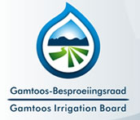




With thanks to
Gamtoos Irrigation Board via the Working for Water Programme for the Department of Environmental Affairs
Notes:
Start with ack
GIB (internship) funding
Help from many other ppl esp in sourcing the imagery
Collaborating Jan Vlok botanist expertise in my study area, does some work in field of spekboom restoration
My supervisor
0:15

Slide 3
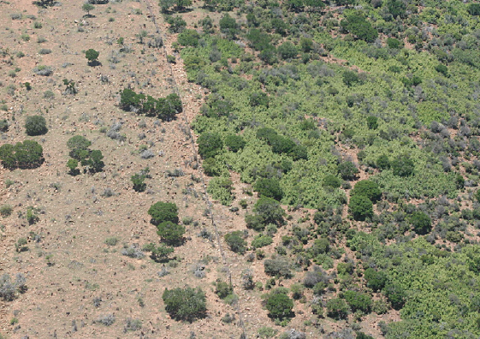
Background
Restoration of degraded Spekboom habitat is beneficial from a number of perspectives.
Spekboom canopy cover maps are needed to help select and monitor restoration sites.
Canopy cover provides information on the level of degradation, economic feasibility and progress of restoration.
There is an initiative to involve private land owners in restoration. Canopy cover maps at 1:10000 scale are required to work at a farm level.
[Source: M. Powell]
Notes:
Some background on motivation for my research.
Spekboom thicket has been irreversibly degraded by overgrazing throughout its range E Cape and Little Karoo FENCELINE CONTRAST!!!
Active restoration has number of benefits, spekboom acts as nurse plant creates fertile env for other plants to re-est in
Very effective at absorbing CO2, potentially gen income through trading cc’s, improves soil quality, water retention, gen employment
I imagine ppl are quite familiar with situation of spekboom being degraded & lot of interest in restoration.
Canopy cover is a first step towards biomass est from RS
1:10000 translates to ~1m pixel res i.e. VHR imagery
Canopy cover maps currently made manually
2:10
[Spekboom is very effective at storing carbon compared to other arid region vegetation (Mills et al. 2005).
Spekboom restoration can be funded by trading carbon credits on the international carbon market (Marais, Cowling & Powell 2009).
Restoration helps provide ecosystem services and employment in impoverished areas (Mills & Cowling 2006).
Restoration research and pilot studies are underway.]
Monitoring currently done manually by expert. Subjective, expensive over large areas.

Slide 4
Objectives
Perform a field study to establish reference sites with ground truth.
Source and calibrate imagery from National Geo-spatial Information (NGI).
Develop a classifier that distinguishes Spekboom from surrounding vegetation & determine Spekboom canopy cover from the classification results.
Notes:
In choosing project I wanted something of practical relevance and use.
Suggested to me by Jan Vlok.
NGI only practical option, other ppl produce high res imagery but v expensive.
Too much to cover in one presentation, focus on calibration & leaving out a lot of detail in development of classification
0:50
Academically some aspects of problem make it quite interesting. i.e.
Speak a bit of rationale
1.40

Slide 5
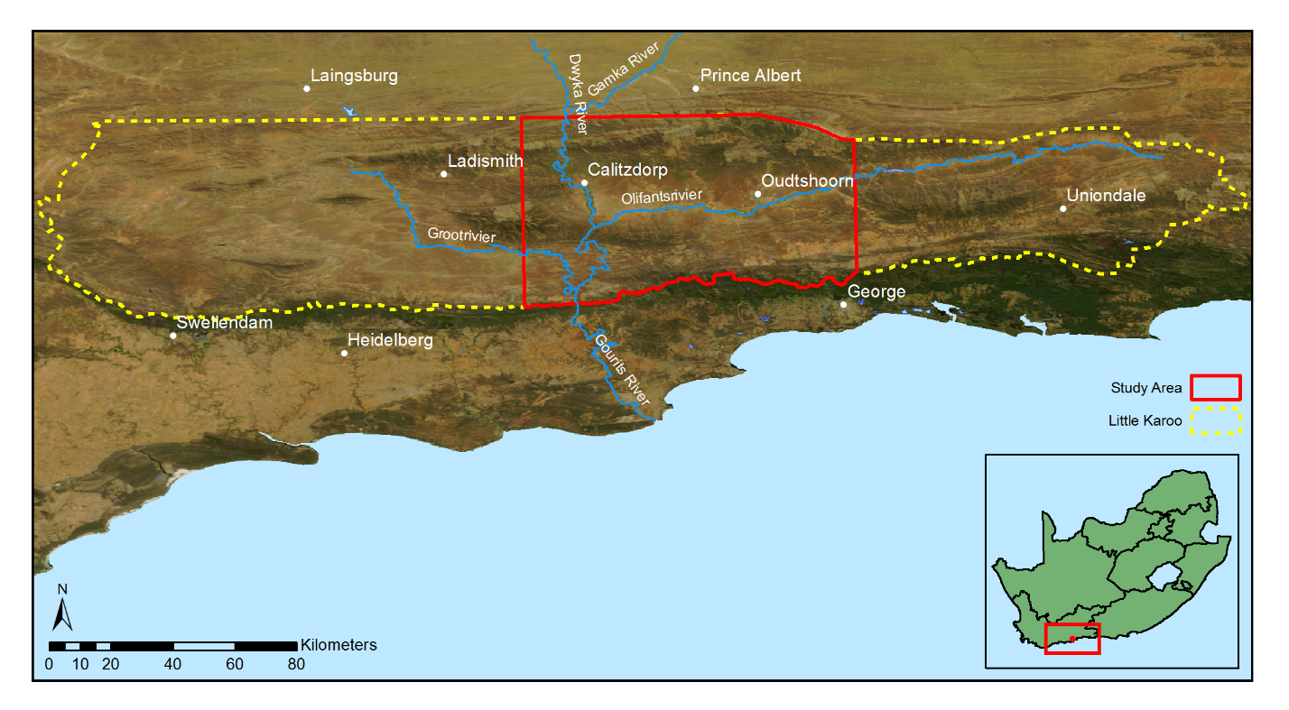
Study Area
Subtropical thicket makes up 35% of the Little Karoo of which roughly 90% is degraded to some extent.
Notes:
Recently have reduced study area as working with imagery for whole of study area was time consuming – give figures – 1 job of calibrated imagery = 400GB
Not practical to test methods on such a large volume of data
Reduced area still presents challenging calibration/classification problem. Methods developed for reduced area will still be applicable to larger area.
1:00
1.45

Slide 6
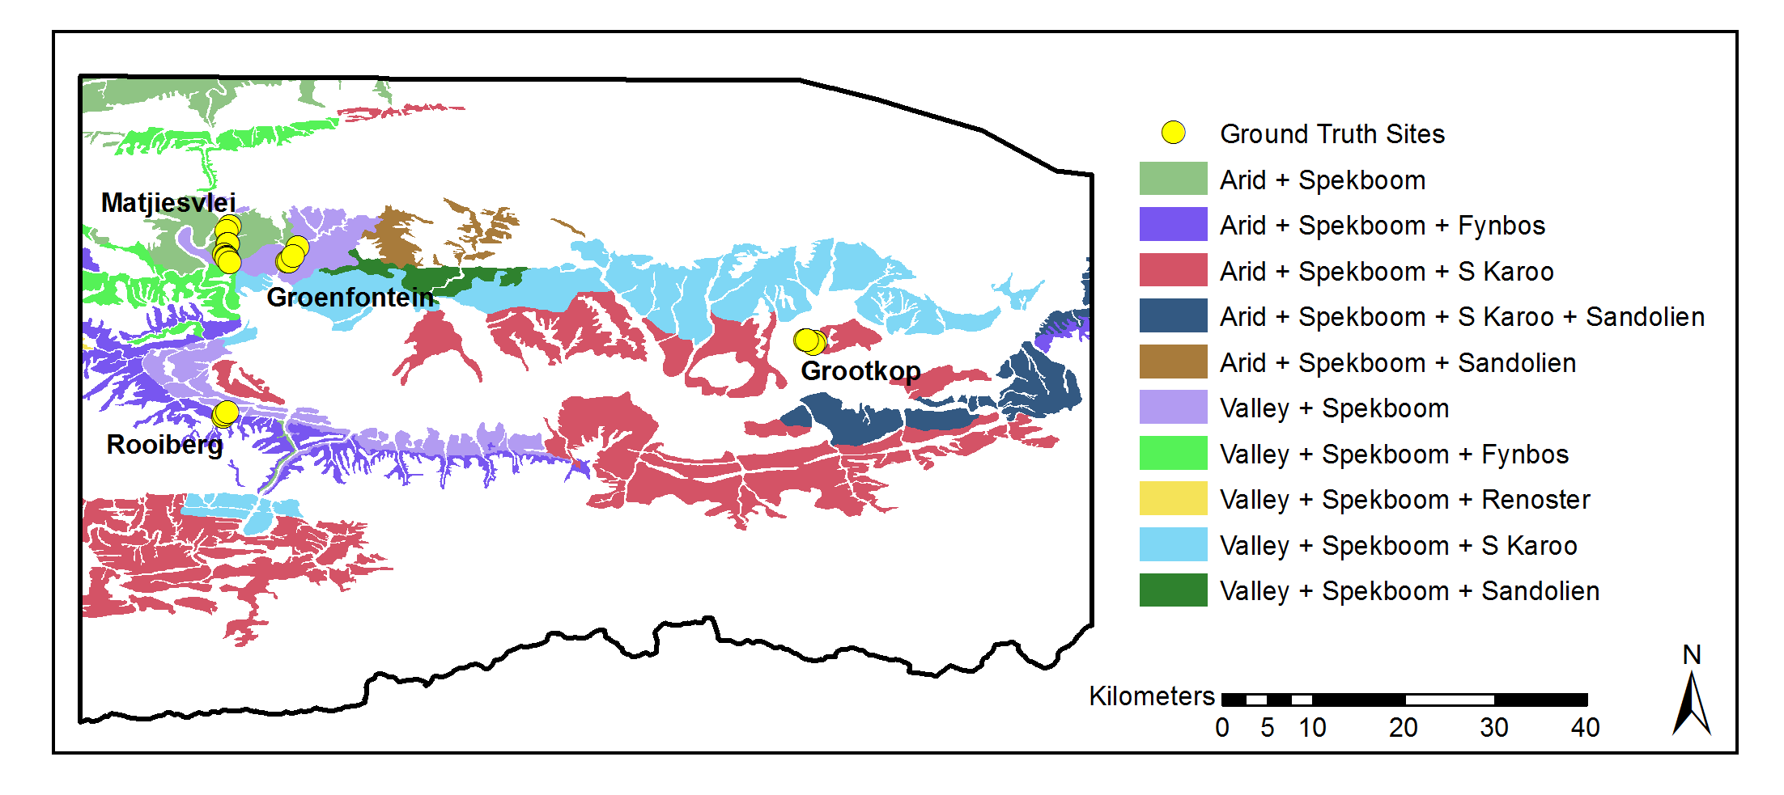
Study Area
Relevant studies have been performed in the area which provide useful ancillary and validation data.
Area was chosen to incorporate as much variation as possible.
Notes:
9 of 10 habitat types
Degradation mapping study at much coarser res + jv’s veg map
It consists of four different aerial survey jobs flown at different times and thus still poses a challenging calibration problem. 2000 individual images.
*** It also includes examples of all the different biomes and nine of the ten habitat types supporting Spekboom
0:40
0:55
1.45

Slide 7
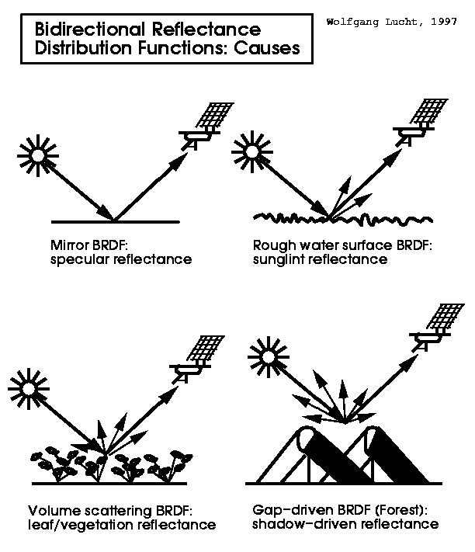
Radiometric Calibration of VHR Aerial Imagery
NGI imagery was most practical source of imagery (0.5m/pixel, 4 band) but no radiometric calibration.
While geometric calibration techniques are well established, radiometric calibration remains a challenge.
Atmospheric influences, bidirectional reflectance distribution function (BRDF) effects and sensor variations all contribute to radiometric variations in the imagery.
Radiometric calibration aims to reduce these unwanted variations and obtain measurement of some physical property of the surface, like reflectance.
Existing radiometric calibration methods are complex and computationally intensive, so we developed our own.
Notes:
2:30
First step was to obtain calibrated imagery. NGI free but no radiometric calibration which is req for quantitative rs. Radiometric = colour / spectral content. For quantitative rs we want to reduce spatial / temporal variations as far as possible. 4 survey jobs of ~ 2000 images in total
Existing techniques for mosaics of aerial imagery… (aerial imagery has special needs)
Radiometric means spectral content or colour.
Recurring theme in literature around problems, extending methods over space and time which is partially calibration issue.
Effects that result in radiometric variation are phsyically complex and difficult to simulate and quantify.
Absolute meas not strictly necessary, so long as consistent can be relative but absolute useful for combining / comparing data, consistency over time.
Also req’d for my research, ngi economical but uncalibrated. Allows fusion w
The high spatial resolution of these images enables analyses on a finer spatial scale than most satellite based platforms can provide and consequently opens up the exploitation of information such as texture, object-based features and unmixed pixel spectra that is not available or less effective in lower resolution images

Slide 8
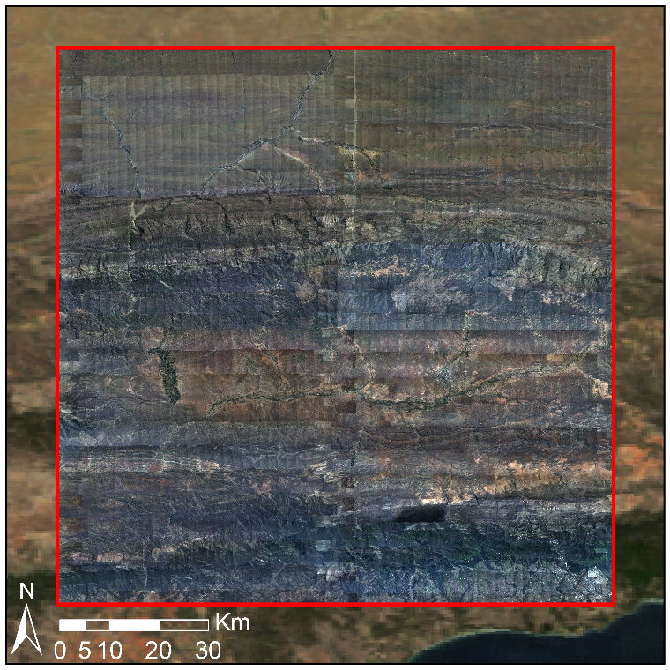
Calibration Results: Uncalibrated NGI Mosaic
Notes:
:30
These are results of our method.
Visual ind of eff
Seamlines & gradients due to brdf, atmospheric effects

Slide 9
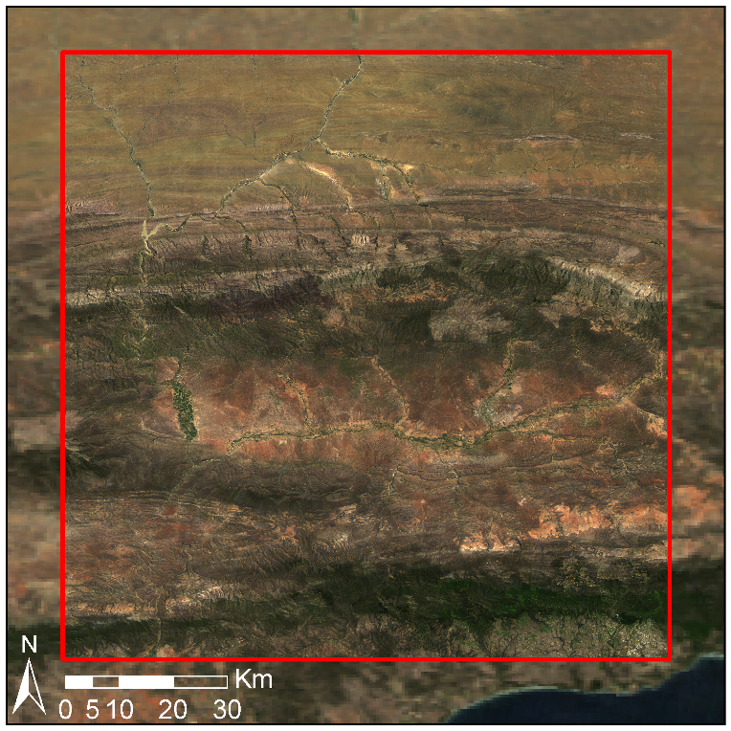
Calibration Results: Calibrated NGI Mosaic
Notes:
:15
Seamlines removed

Slide 10
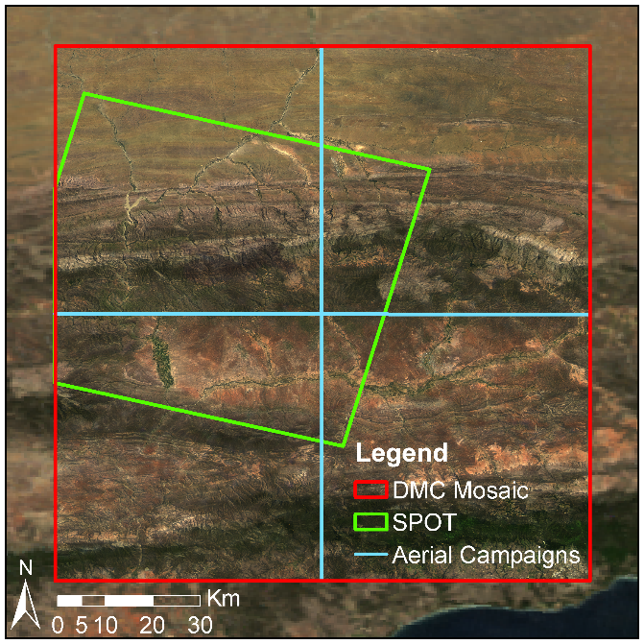
Calibration Results: Comparison to SPOT
10m resolution SPOT 5 level 1A image.
Orthorectified and corrected to surface reflectance using ATCOR 3.
Notes:
:45
While the results are visually compelling, we wanted to compare to a independent ref and one closer to res of NGI.
SPOT as independent

Slide 11
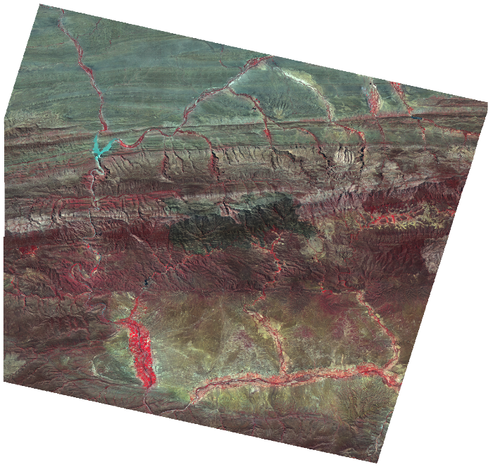
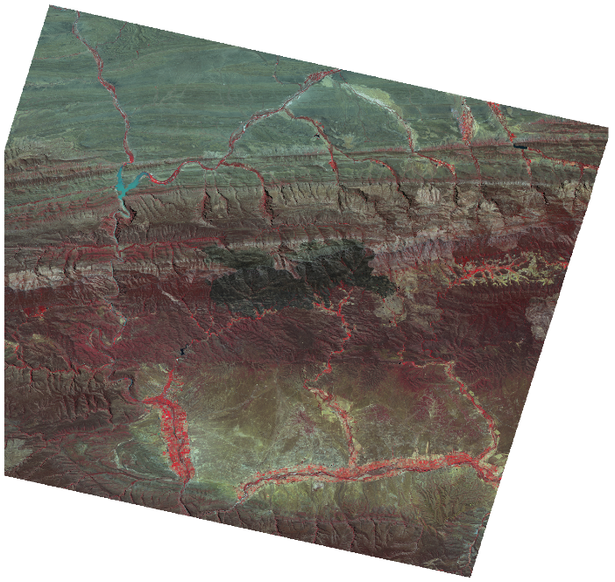
Calibration Results: Comparison to SPOT
Mean absolute reflectance difference of 3.92%
NGI Calibrated Mosaic
SPOT Surface Reflectance
Notes:
:40
Comparison, colour-infrared NGI mosaic to concurrent SPOT surface refl. Very similar. Considering simplicity of method is very good result, better than other est methods.
While SPOT is known to have its own calibration challenges, the similarity of these is strong indication that something is working well.
Quantitative rs on eerial imagery of large scales still fairly uncommon mainly due to calibration issues, methods struggle to generalise over spatial/temporal, recurring theme in rs
Hope this will help open up NGI imagery to other rs, as it is valuable source of info that has been underutilised

Slide 12
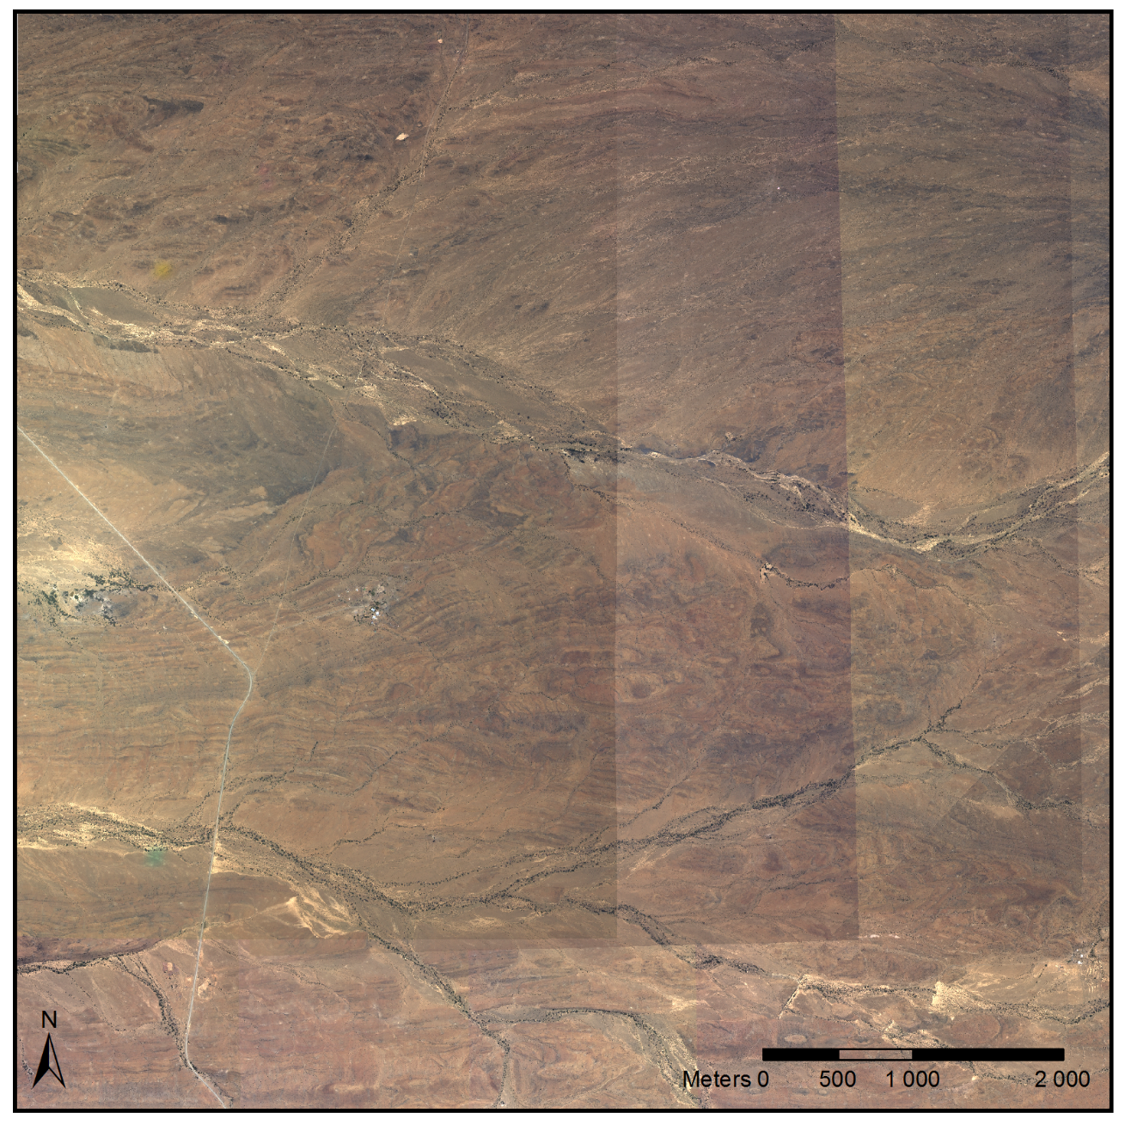
Calibration Results: Hot-spots and Seam Lines
NGI Uncalibrated Close-Up
Notes:
Bright spot is hot spot, refl of sun that happens in certain terrains. Not real and eg of BRDF.
0:30

Slide 13
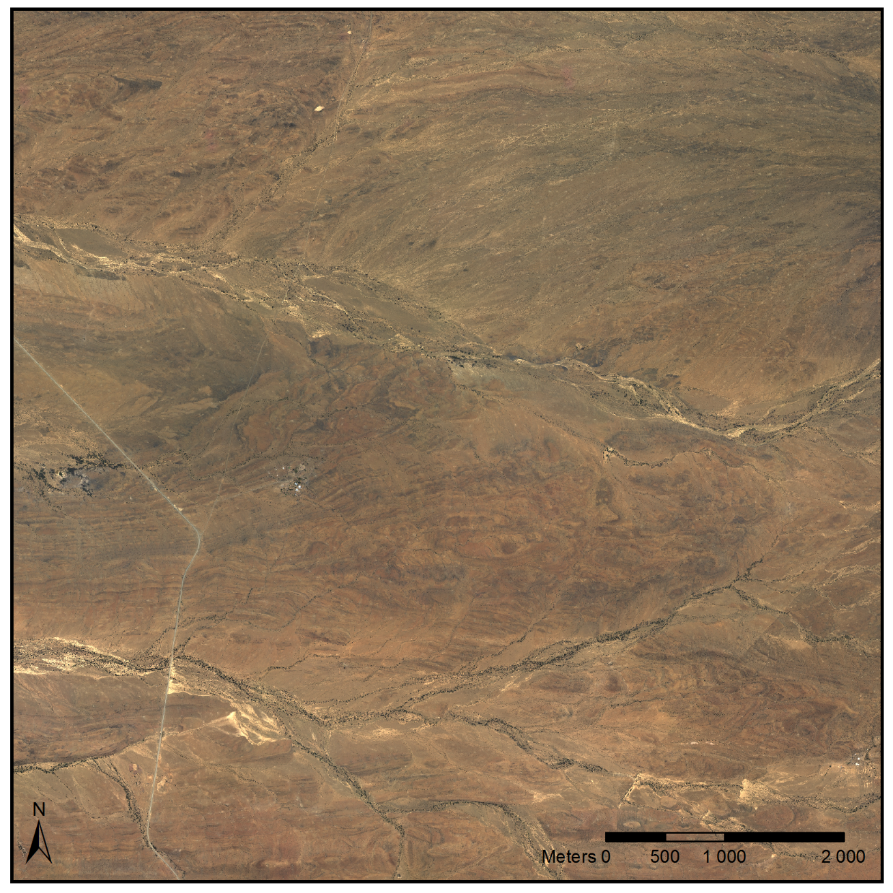
Calibration Results: Hot-spots and Seam Lines
NGI Calibrated Close-Up
Notes:
:45

Slide 14
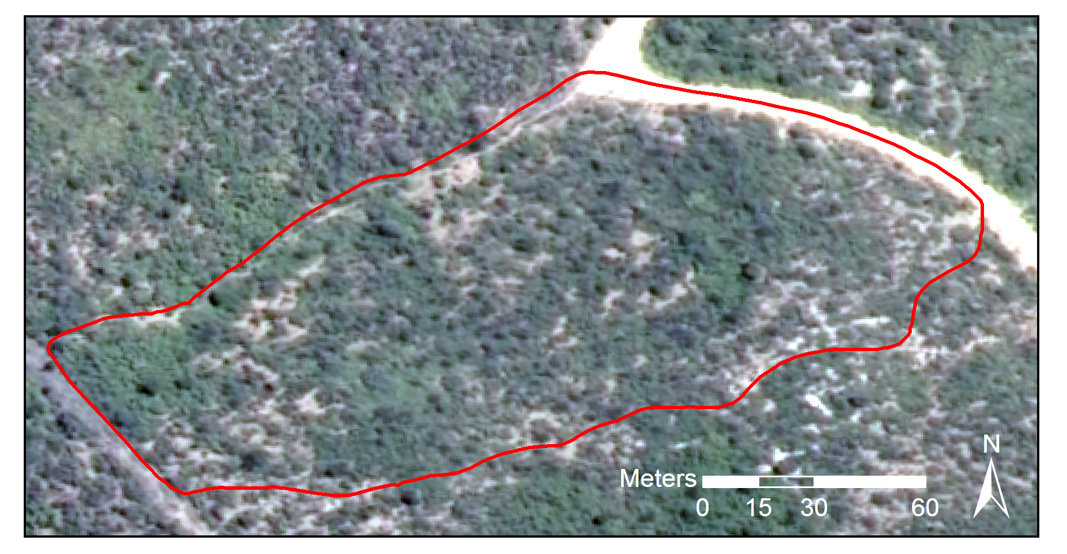
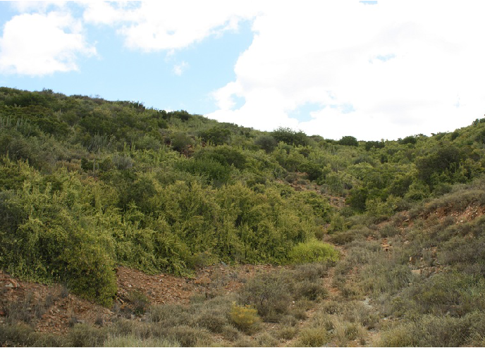
Classification: Field Ground Truth
Ground truthing exercise conducted in collaboration with Jan Vlok.
20 sites of roughly a hectare each were selected to encompass variation in geology, biome and level of degradation.
Boundary polygons were recorded with a DGPS device.
Estimates of canopy cover inside the polygons were established visually and reference photos captured.
Notes:
Departments trimble device
Representative (degradation, geology, habitat)
0:50

Slide 15
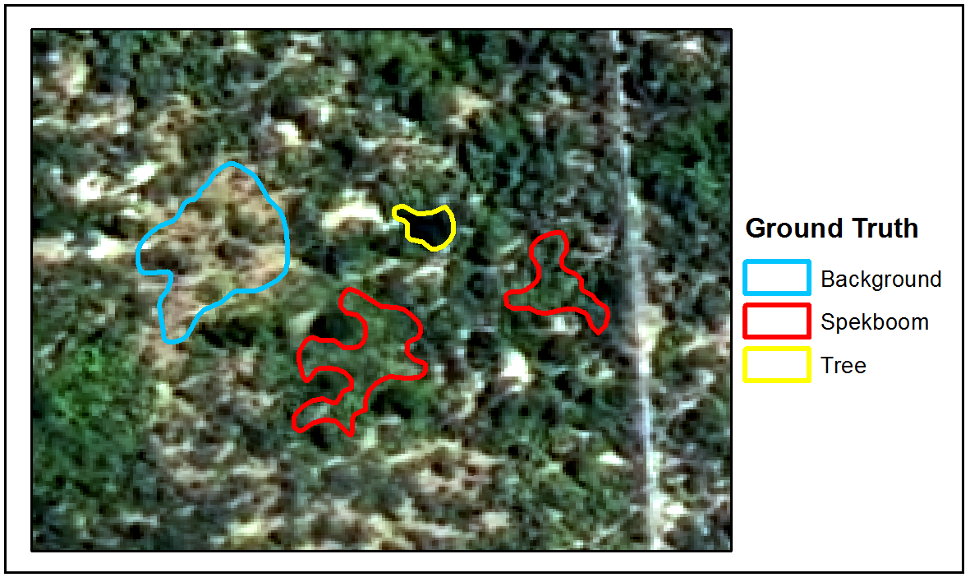
Classification: Image Ground Truth
Ground truth data established by hand-labelling polygons.
46 spectral, textural and vegetation index features were evaluated.
A method of selecting features in the presence of correlation was developed and used to select a reduced set of 6 informative features.
A number of classifiers (KNN, normal Bayes, SVM, random forest, decision tree) were evaluated.
Decision tree selected as it achieved best results on field ground truth and was the second fastest
Notes:
Supervised classification, ground truth for training
Found traditional fs was sensitive to correlation amongst features, devised a way that was robust to this
All clfrs performed similarly, suggesting good features
Processing times are long for VHR imagery so a lot of emphasis was placed computational speed in features that were used and classifier
1:40
Wanted an idea if imagery calibrated would it be possible to classify spekboom.
1:20

Slide 16
Classification - Results
A mean absolute canopy cover error of 6% was obtained over 20 ground truth sites.
Overall the performance was surprisingly good although some sites proved problematic.
Area | Num. | Ground Truth (%) | Classifier (%) | Expert (%)
Groenfontein | 1 | 0.00 | 0.07 | 1.50
 | 2 | 4.00 | 0.47 | 11.00
 | 3 | 10.00 | 8.21 | 20.00
 | 4 | 25.00 | 17.44 | 27.50
Matjiesvlei | 1a | 6.00 | 7.21 | 20.00
 | 1b | 22.50 | 31.37 | 52.50
 | 2 | 70.00 | 67.38 | 87.50
 | 3 | 85.00 | 73.12 | 90.00
 | 4 | 65.00 | 70.34 | 95.00
 | 5 | 37.50 | 35.95 | 87.50
 | 6 | 17.50 | 12.01 | 77.50
 | 7 | 15.00 | 25.74 | 87.50
 | 8 | 2.00 | 5.42 | 20.00
Rooiberg | 1 | 20.00 | 6.03 | 27.50
 | 2 | 11.00 | 1.03 | 5.05
 | 3 | 0.00 | 0.00 | 1.01
Grootkop | 1 | 22.50 | 8.05 | 20.00
 | 2 | 0.50 | 0.22 | 0.51
 | 3 | 42.50 | 34.38 | 57.50
 | 4 | 77.50 | 71.27 | 77.50
MAE (SAE)ª |  |  | 5.85% (4.65%) | 17.50% (20.98%)
 | Background | Spekboom | Total | PA (%)ª
Background | 30103 | 514 | 30617 | 98.32
Spekboom | 1491 | 25769 | 27260 | 94.53
Total | 31594 | 26283 | 57877
CA (%)ª | 95.28 | 98.04
Kappa | 0.93
Overall Error (%) | 3.57
Notes:
Performance on image ground truth extremely good – 3.57% overall error.
Performance on field ground truth good – 5.85%. Tendency to overest in densely veg areas and underest in more arid / degraded areas. But accurate and useful nevertheless.
Clfr beats expert estimates from images. All things considered, I’m very happy with these results.
1:20
Some error present in ground truth itself as was an estimate,
Difference in error suggests image ground truth not that repr of field ground truth. Not v surprising as image areas were chosen where certainty as to class which means more challenging eg’s omitted .

Slide 17
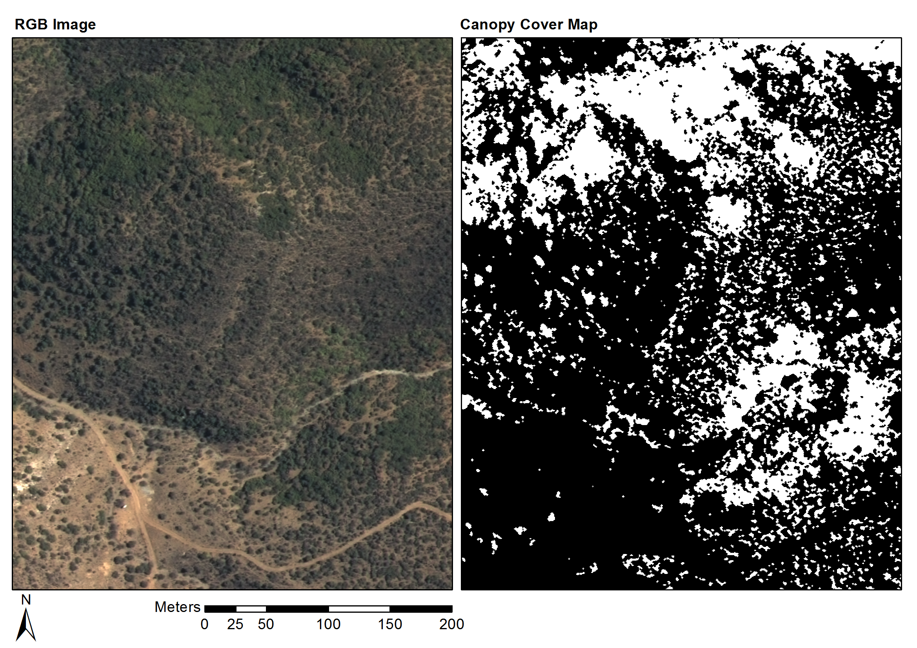
Classification - Results
Notes:
Figure show example results.
RH images display prob that a pix is Spekboom (white = 100% prob, black 0%). Have checked with Jan Vlok that these images are Spekboom thicket
60
Groenfontein, shale, moderate – sever degradation

Slide 18
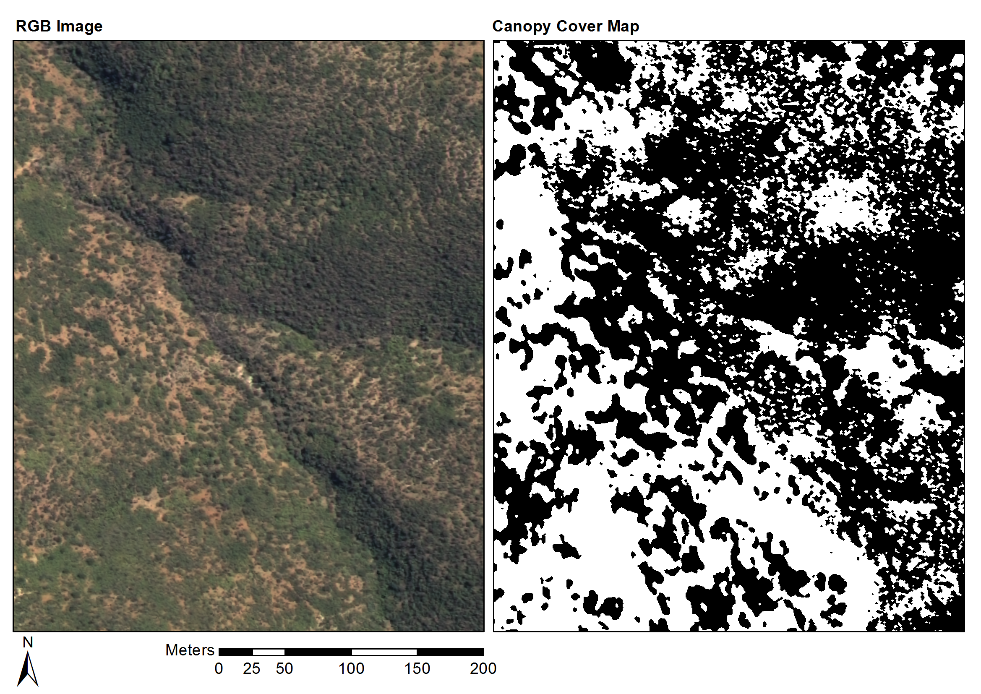
Classification - Results
Notes:
Matjiesvlei, shale, pristine

Slide 19
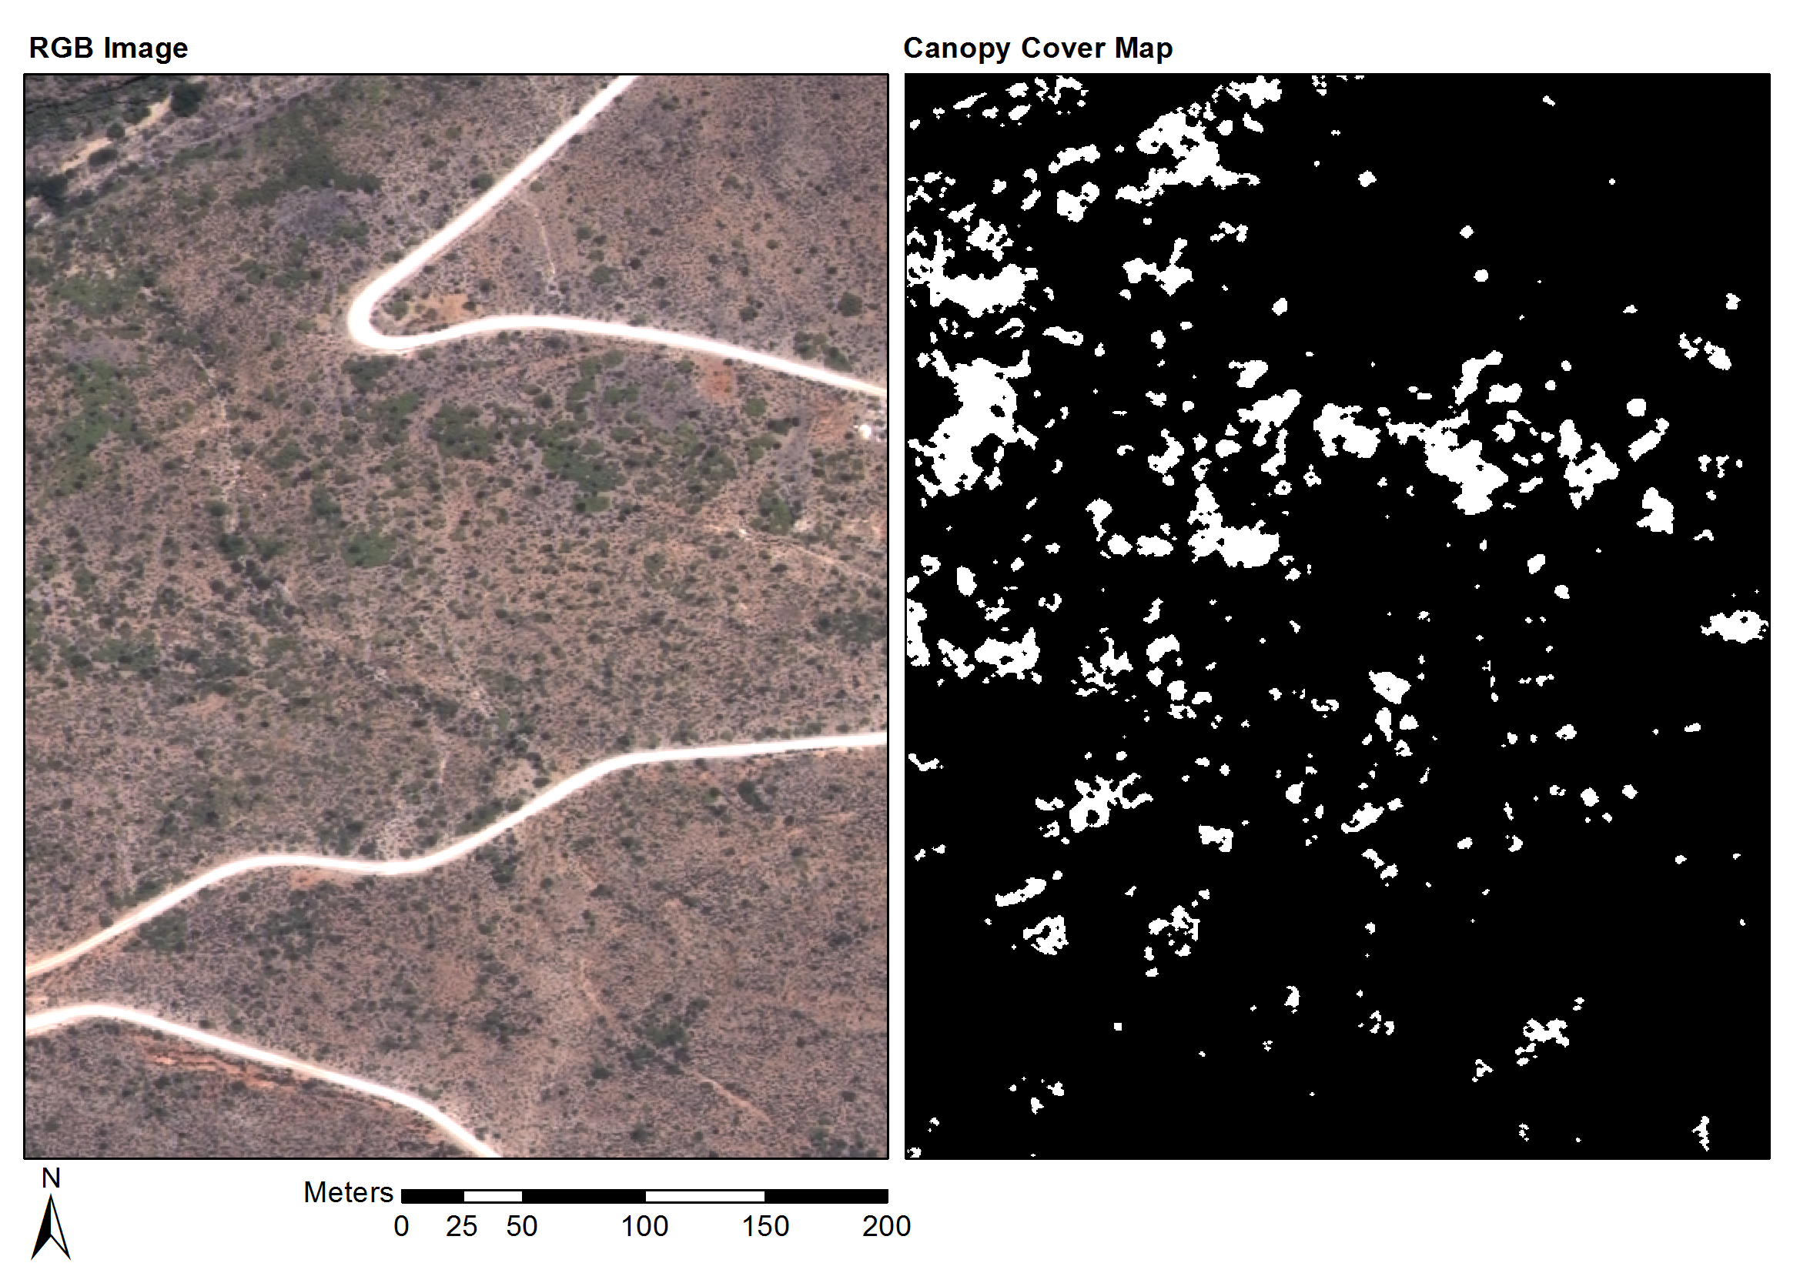
Classification - Results
Notes:
Fynbos mosaic area, prev farm quite degraded, sandstone
Figure show example results. RH images display prob that a pix is Spekboom (white = 100% prob, black 0%). Have checked with Jan Vlok that these images are Spekboom thicket
0:50

Slide 20
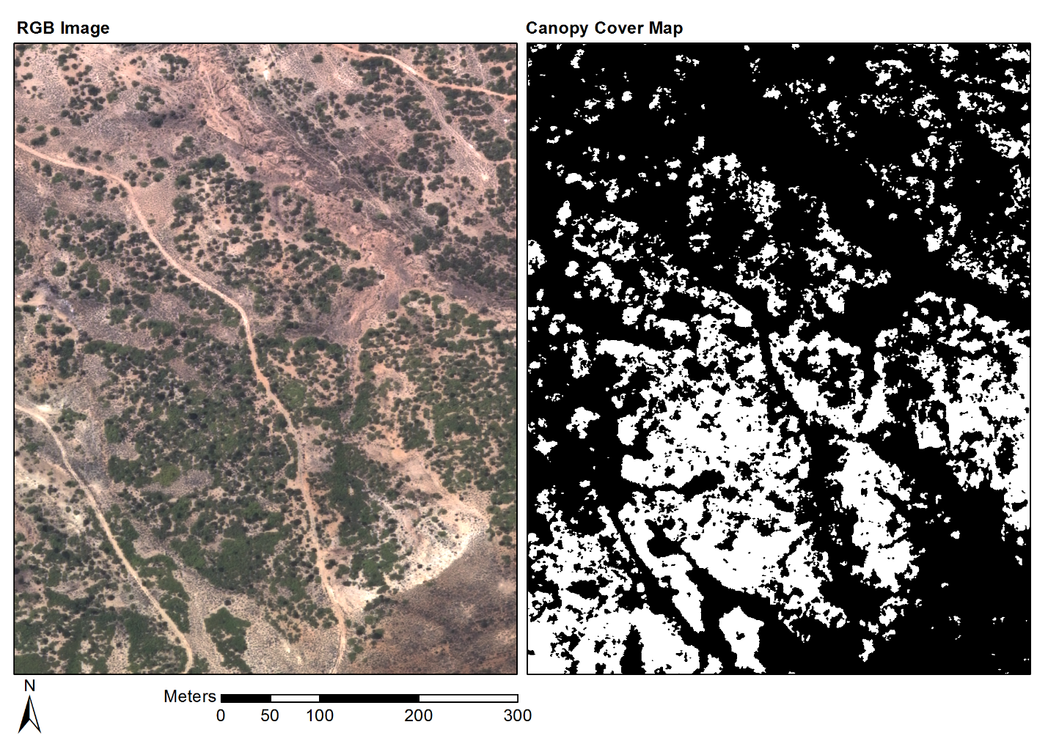
Classification - Results
Notes:
Grootkop. Succ. Karoo mosaic. Close to Oudtshoorn, parts quite degraded, . Enon conglomerate

Slide 21
Classification
Classification Close-up
Notes:
2:00 from 5 slides back
Close-up showing boundary of classified area.
Dark blobs are Euclea and Pappea trees and should be excluded

Slide 22
References
Eisfelder C, Kuenzer C & Dech S 2012. Derivation of biomass information for semi-arid areas using remote-sensing data. International Journal of Remote Sensing 33 (9): 2937–2984.
Forsyth G, Vlok J & Reyers B 2008. Retention and restoration of the biodiversity of the Little Karoo. CSIR Report No CSIR/NRE/ECO/ER/2008/0118/C. Critical Ecosystem Partnership Fund, CSIR.
Lu D 2006. The potential and challenge of remote sensing based biomass estimation. International Journal of Remote Sensing 27 (7): 1297-1328.
Marais C, Cowling RM & Powell M 2009. Establishing the platform for a carbon sequestration market in South Africa: The Working for Woodlands Subtropical Thicket Restoration Programme. In XIII World Forestry Congress, 1-13. Buenos Aires, Argentina.
Mills AJ, Cowling RM, Fey M, Kerley G, Donaldson J, Sigwela A, Skowno A & Rundel P 2005. Effects of goat pastoralism on ecosystem carbon storage in semiarid thicket , Eastern Cape , South Africa. Austral Ecology 30: 797-804.
Mills AJ & Cowling RM 2006. Rate of carbon sequestration at two thicket restoration sites in the Eastern Cape, South Africa. Restoration Ecology 14 (1): 38-49.
Thompson M, Vlok J, Rouget M, Hoffman MT & Cowling RM 2009. Mapping grazing-induced degradation in a semi-arid environment: A rapid and cost effective approach for assessment and monitoring. Environmental Management 43: 585-596.
Vlok J, Cowling RM & Wolf T 2005. A vegetation map for the Little Karoo. Unpublished maps and report for a SKEP project supported by CEPF grant no 1064410304.
Chandelier L, & Martinoty G 2009. A radiometric aerial triangulation for the equalization of digital aerial images and orthoimages. Photogrammetric Engineering & Remote Sensing 75(2), 193–200.
Collings S, Caccetta P, Campbell N & Wu X 2011. Empirical models for radiometric calibration of digital aerial frame mosaics. IEEE Transactions on Geoscience and Remote Sensing 49(7), 2573–2588.
Jain A, Duin R, & Mao J 2000. Statistical pattern recognition : A review. IEEE Transactions on Pattern Analysis and Machine Intelligence, 22(1), 4–37.
Jiang G-M & Li Z-L 2009. Cross-calibration of MSG1-SEVIRI infrared channels with Terra-MODIS channels. International Journal of Remote Sensing 30(3), 753–769.
Li L, Yang J & Wang Y 2012. Cross-calibration of HJ-1B/CCD1 image based on Aqua/MODIS data. 2012 Second International Workshop on Earth Observation and Remote Sensing Applications, 1–4.
Strahler A 1999 MODIS BRDF Albedo Product : Algorithm Theoretical Basis Document, 1–53.
Eisfelder C, Kuenzer C & Dech S 2012. Derivation of biomass information for semi-arid areas using remote-sensing data. International Journal of Remote Sensing 33 (9): 2937–2984.
Notes:
Mostly new calib references

Slide 23
Questions?

